Slide 1
FCFL A Fairness Compensation-based Federated Learning Scheme with Accumulated Queues
0423052090 – Asif Ahmed Utsa
0424052053 – Mobaswirul Islam

Slide 2
Research Paper
FCFL: A Fairness Compensation-Based Federated Learning Scheme with Accumulated Queues
Lingfu Wang, Zuobin Xiong, Guanchun Luo, Wei Li, Aiguo Chen
Conference: ECML PKDD 2024

Slide 3
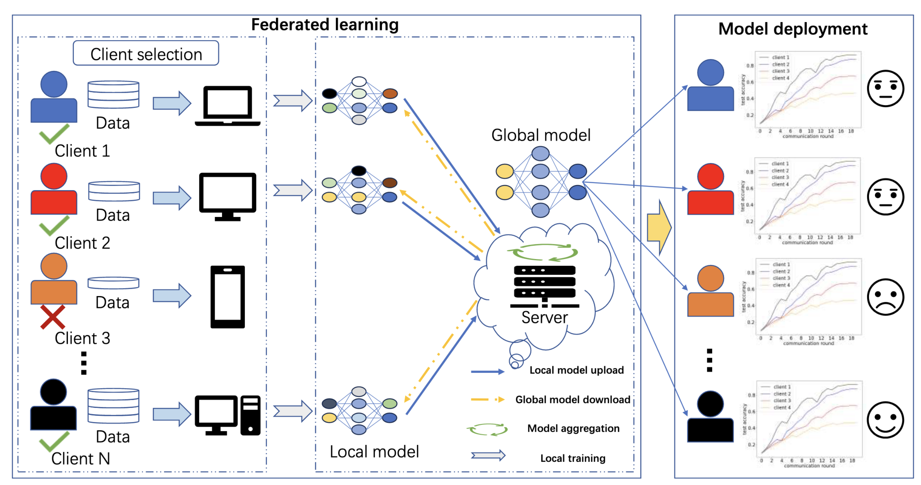
Federated Learning
Diverse Data Sources
Data Security or Privacy
Data Transfer costs

Slide 4
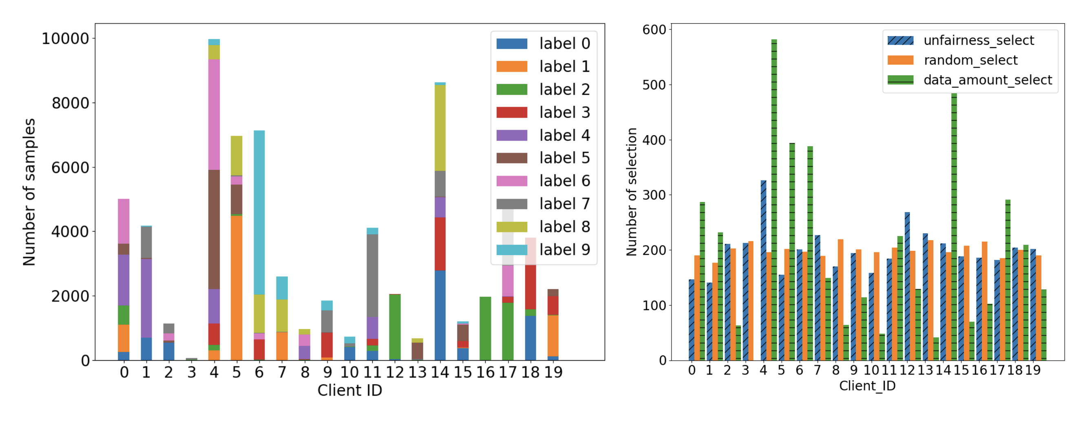
Federated Learning - Issues
Data and System Heterogeneity
Unfairness
Participation Imbalance

Slide 5
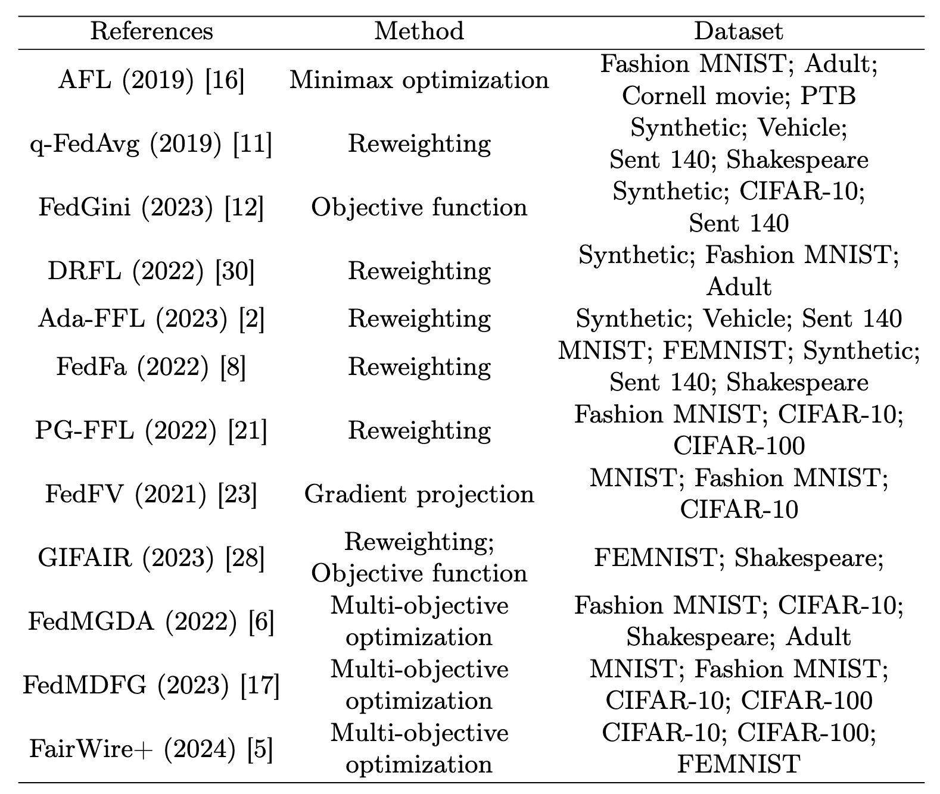
Previous Works
Designing Novel Objective Functions
Reweighting
Eliminating Gradient Conflicts
Multi-objective Optimization

Slide 6
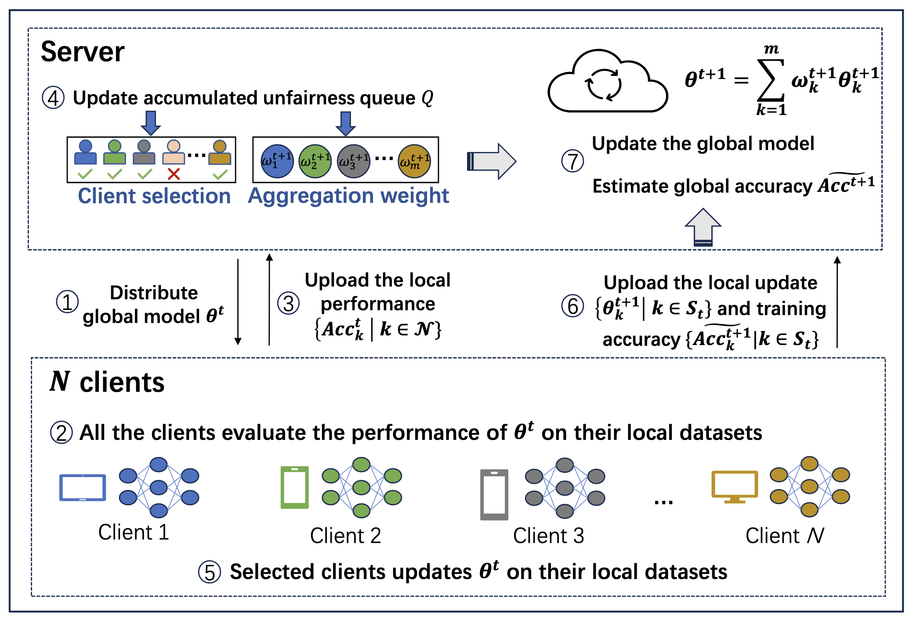
FCFL - Overview

Slide 7
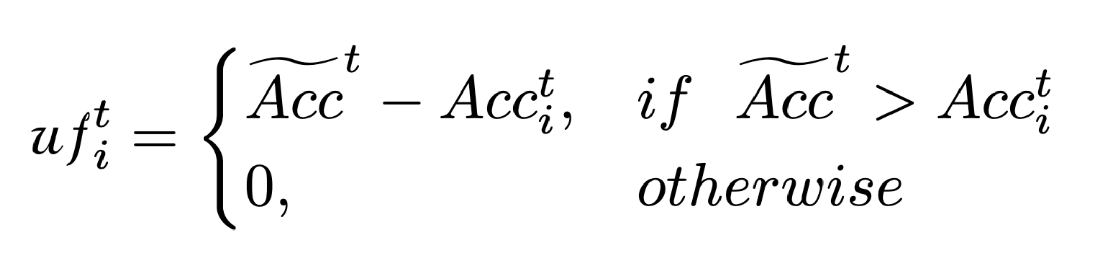
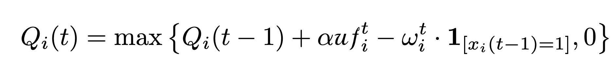
FCFL – Accm Unfairness Queues
Qi​(t) accumulates per‑round unfairness or low‑accuracy clients
Not selected ⇒ queue increases
Small aggregation weight
⇒ minor penalty
→ queue remains high

Slide 8
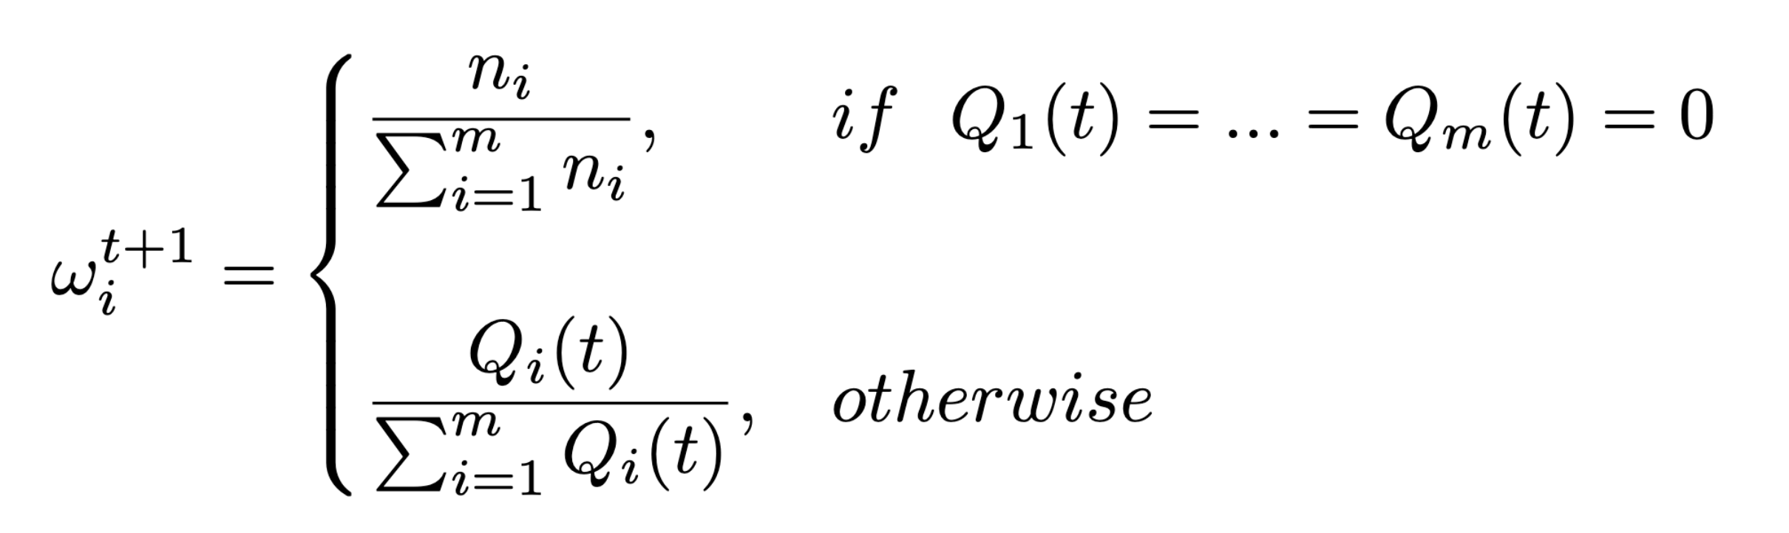
Client Selection and Aggregation Reweighting
Biasness towards vulnerable clients.
+ Randomly selected r% clients.

Slide 9
Experiment Setup
Datasets & Models
MNIST – CNN
CIFAR10 – MLP
Shakespeare – RNN + LSTM Layer
Baseline Methods
FedAvg
Q-FedAvg
FedFa
GIFAIR

Slide 10
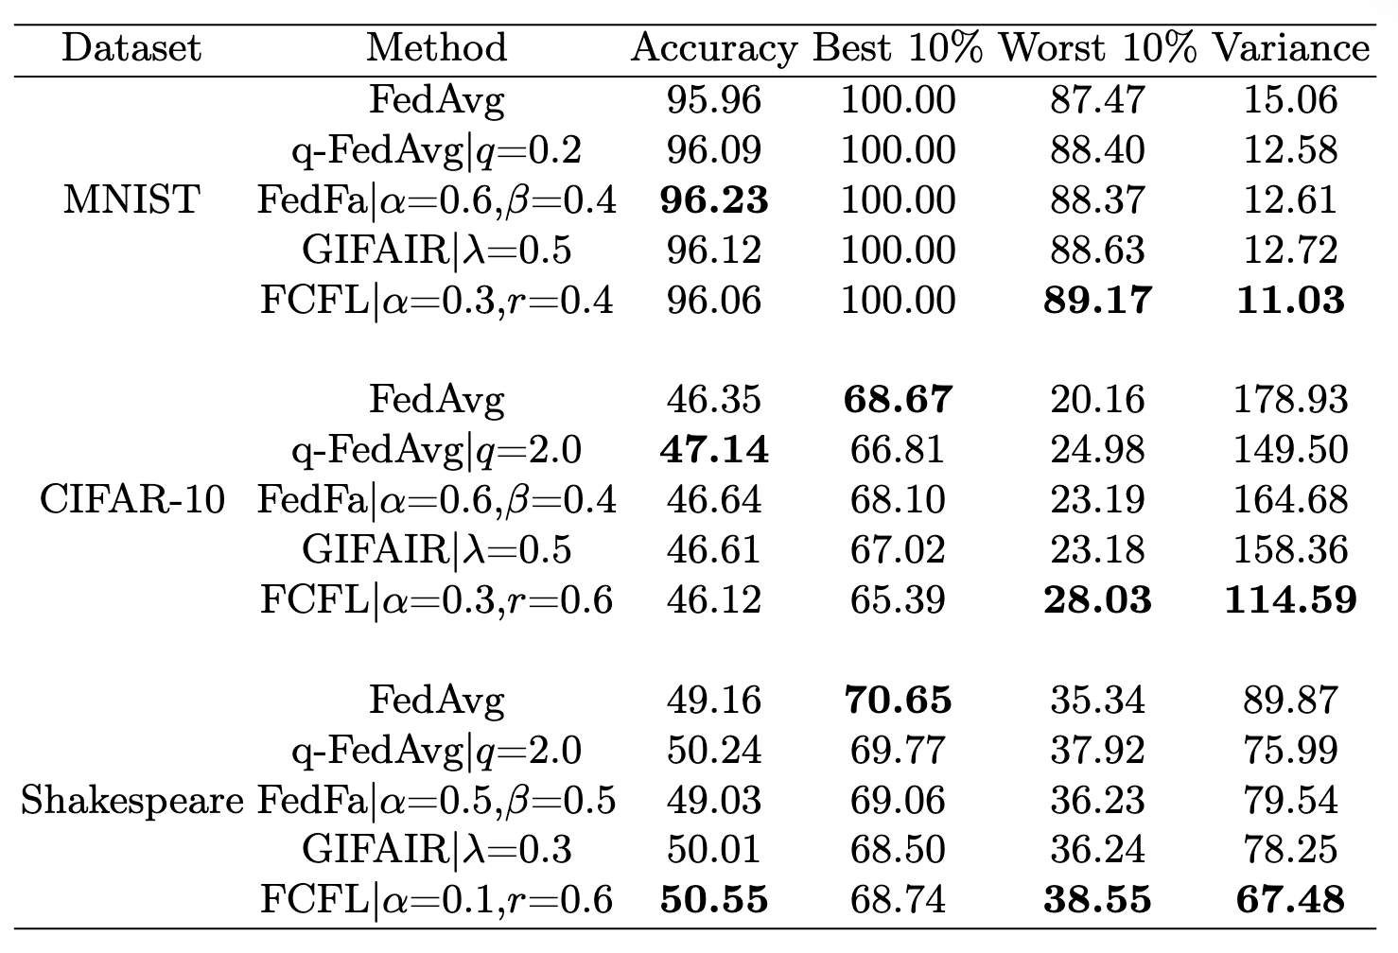
Fairness of FCFL

Slide 11
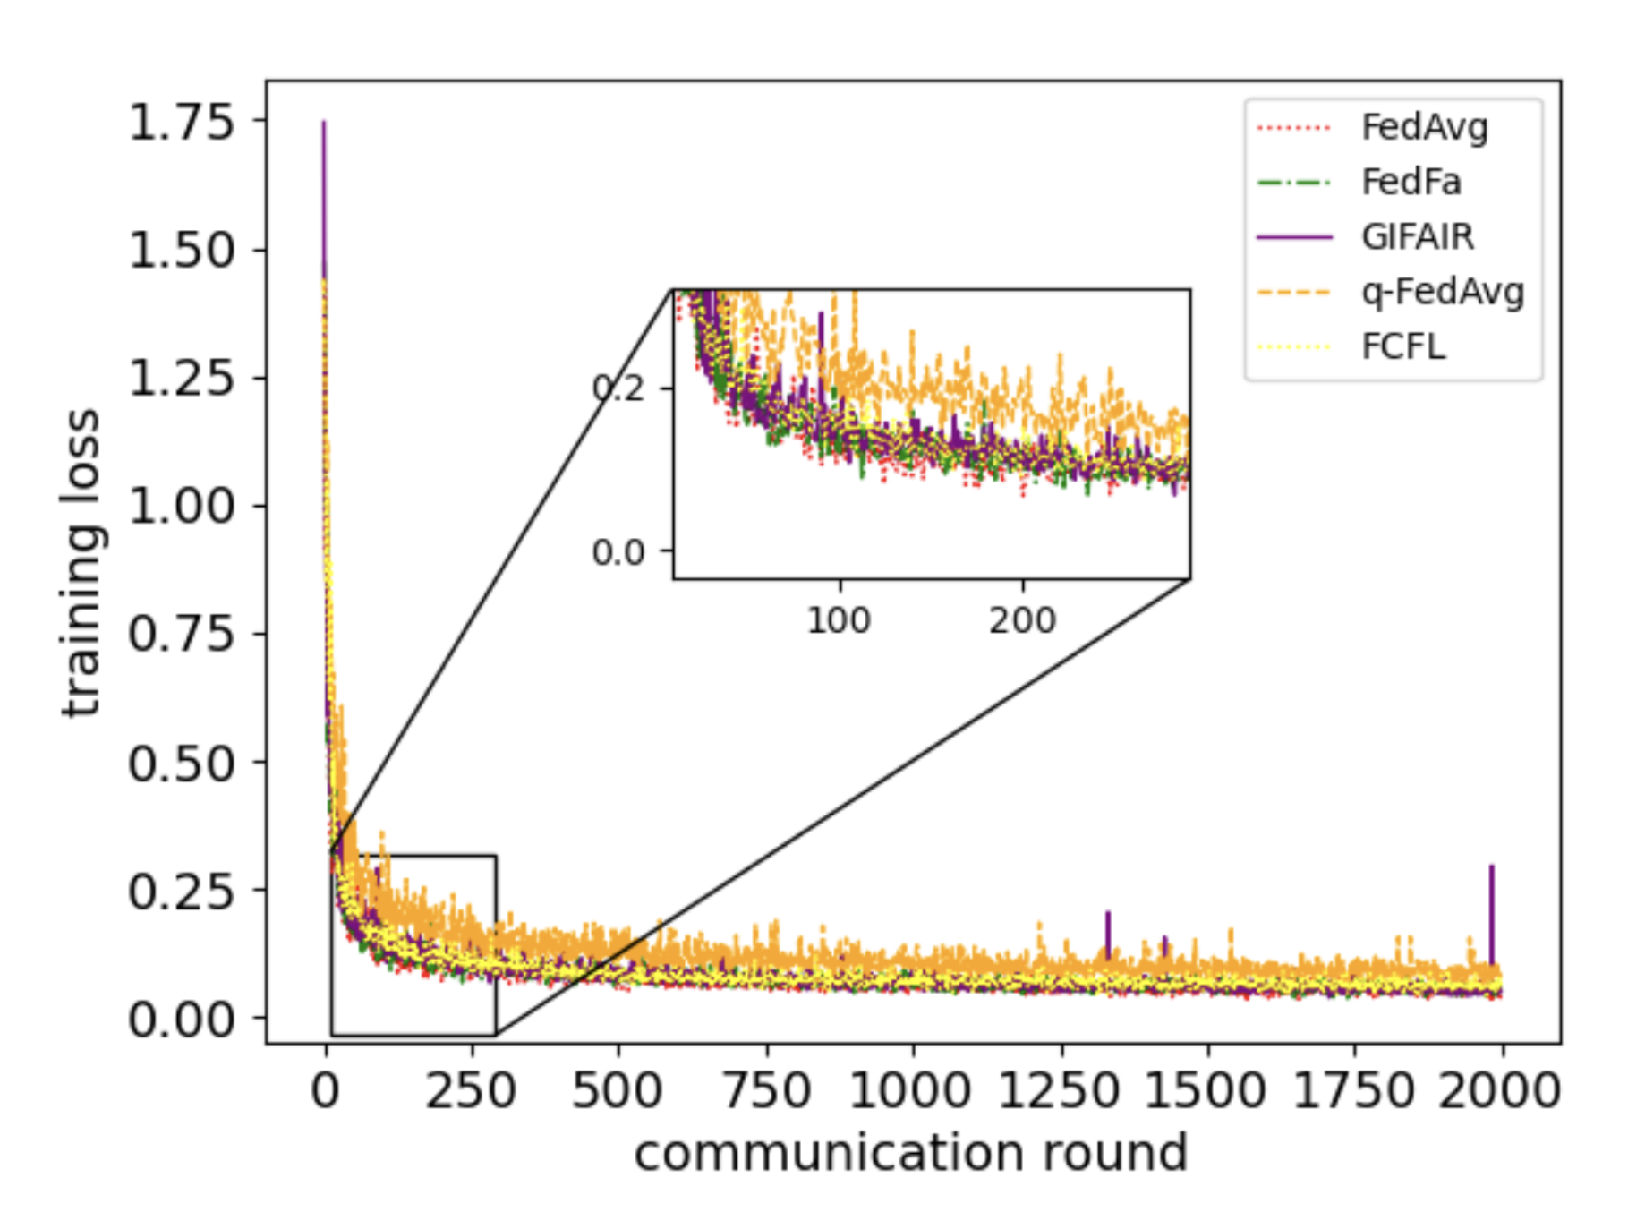
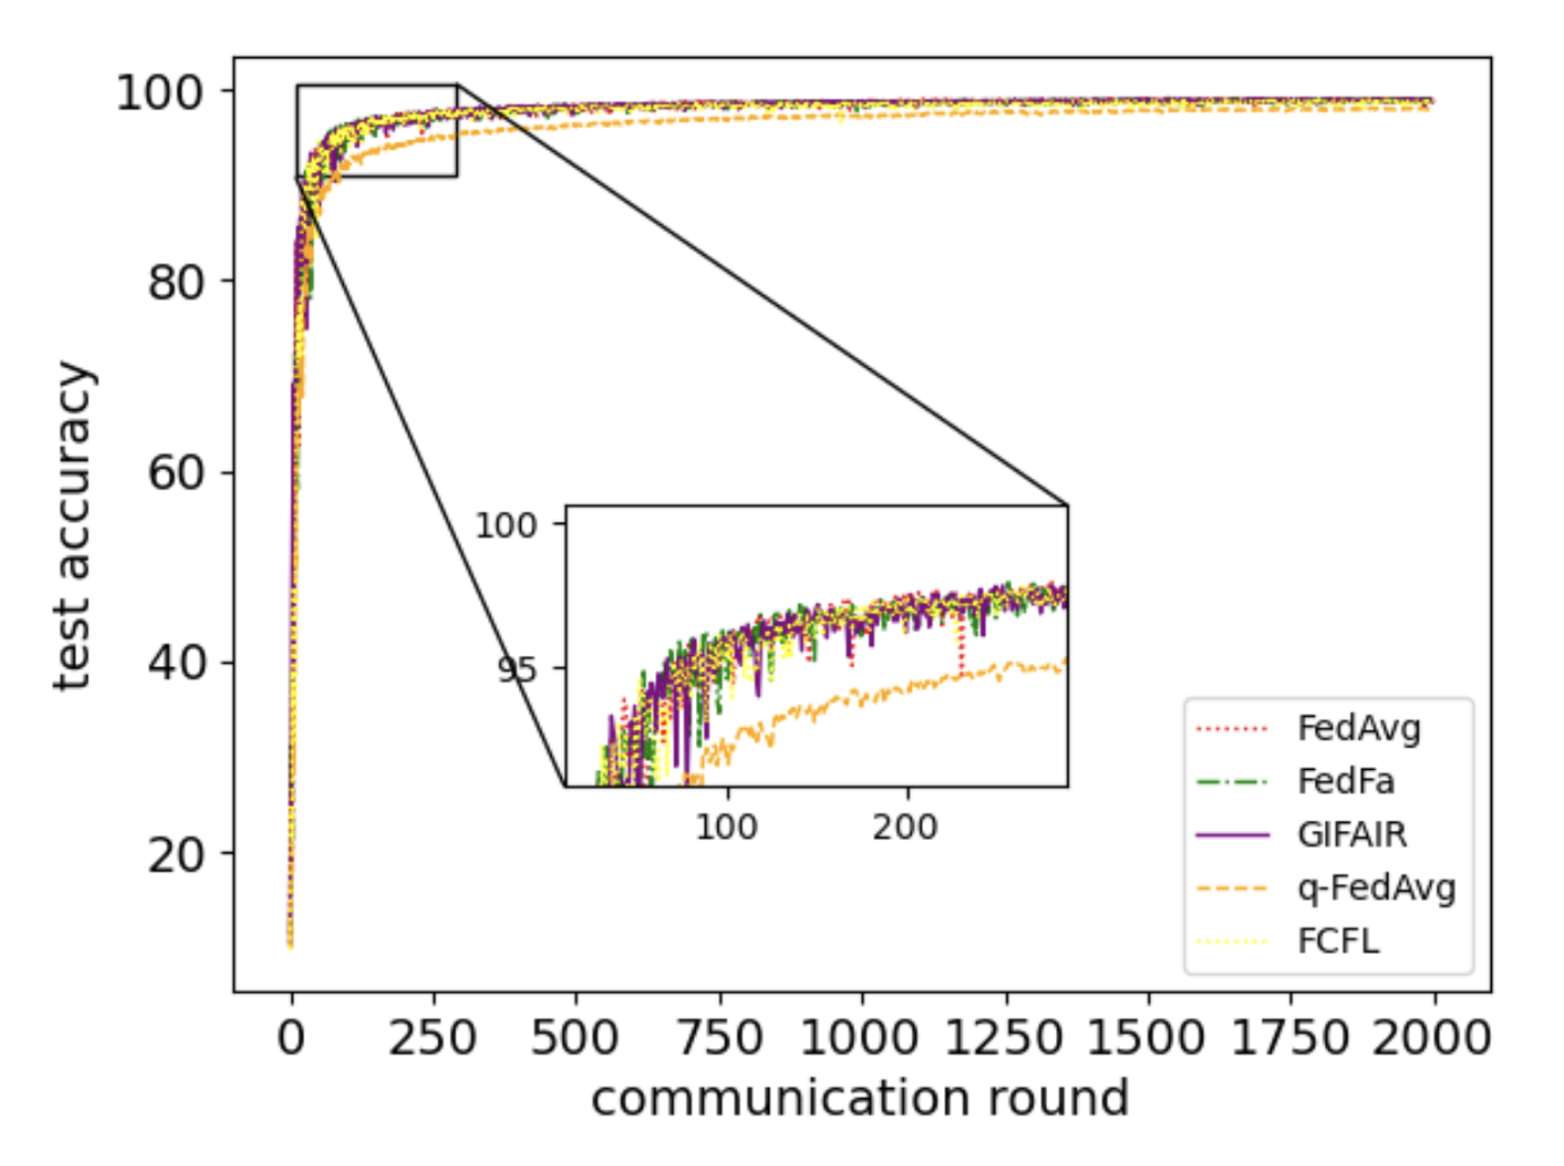
Efficiency of FCFL

Slide 12
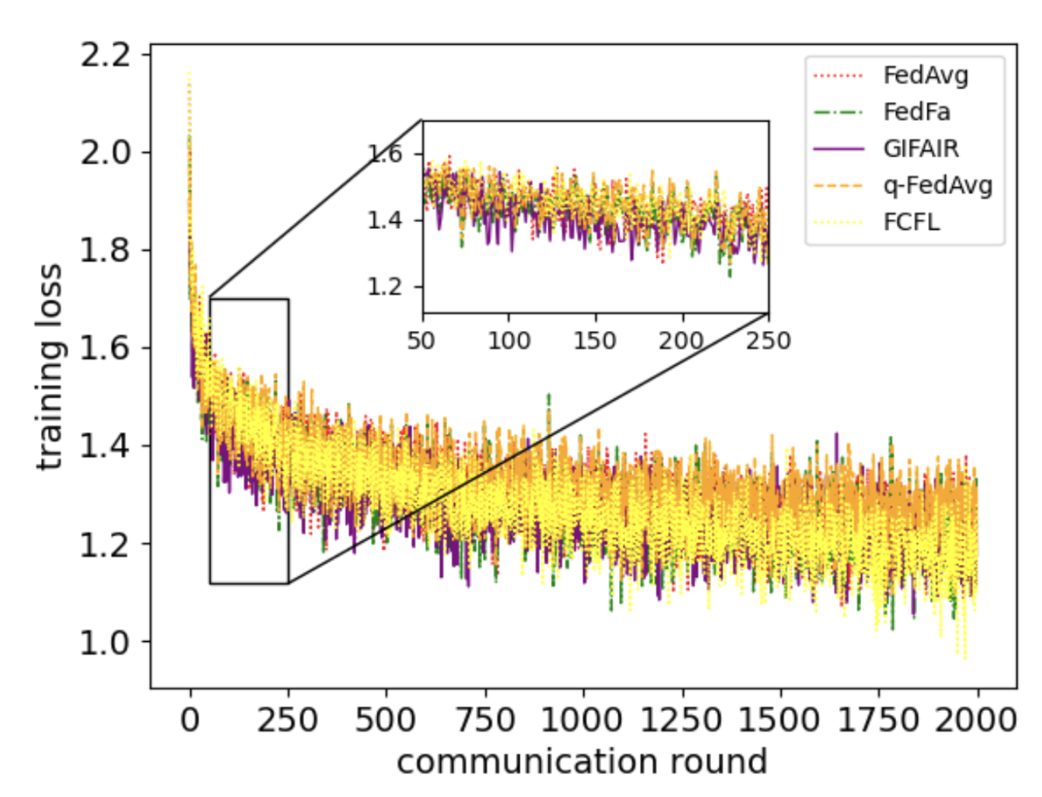
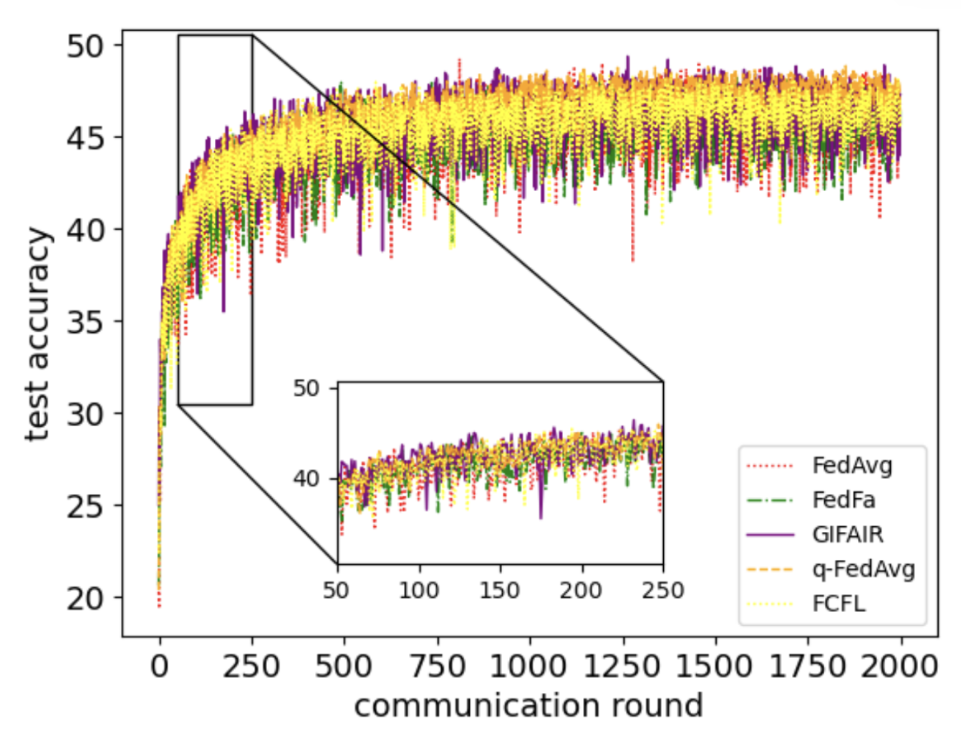
Efficiency of FCFL

Slide 13
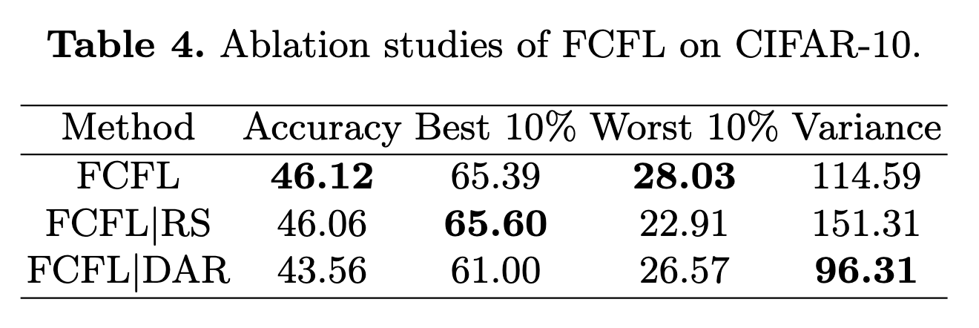

Slide 14
Limitations
Not tested on large scale highly heterogenous datasets.
Focused on accuracy based fairness.
Potential for overcompensation for certain vulnerable clients.

Slide 15
Future Works
Improving Unfairness Calculation
Incorporating global performance
Multi fairness integration
Adaptive Hyper Parameters (alpha, r) selection

Slide 16

Thank you

